Slide 1
VANCOUVER CRIME REPORT ANALYSIS
Presented By
Cedrick Daez
Naveen Chander Madanagopal
Dwit Krushakkumar Bhavsar
John Jethro Sauco
Notes:
Title: Vancouver Crime Report Analysis
Group 3: Cedrick Daez
Naveen Chander Madanagopal
Dwit Krushakkumar Bhavsar
John Jethro Sauco

Slide 2
AGENDA:
INTRODUCTION
TYPES OF CRIME
CRIMES PER DAY
PER DAY OF THE WEEK
CRIMES PER HOUR
BY MONTH
BY YEAR
BY NEIGHBOURHOOD
TOTAL NUMBER OF CRIMES
RECOMMENDATIONS
CONCLUSION

Slide 3
INTRODUCTION
Kaggle - It contains the dataset of crime in Vancouver. (https://www.kaggle.com/datasets/wosaku/crime-in-Vancouver)
Data from 2003-01-01 to 2017-07-13 and it contains 530,652 records.
What are the various types of crime in Vancouver?
What's the distribution of crimes per day?
Which days have the highest and lowest average number crimes?
Is crime decreasing or increasing?
Which are the safest and dangerous area in Vancouver?
Which hour has the maximum crime rate over the given period of time?
Notes:
The data was taken from the Kaggle it contains the dataset of crime in Vancouver city.
IT includes the data from 2003-01-01 to 2017-07-13 it contains 530,652 records.
The approach to this project was to explore the data firstly, then draw out the distinct questions that come to mind a first glance of the data:
What's the distribution of crimes per day?
Which days have the highest and lowest average number crimes?
Is crime decreasing or increasing?
What are the various types of crime in Vancouver?
Which are the safest and dangerous area in Vancouver?
Which hour has the maximum crime rate over the given period of time?

Slide 4
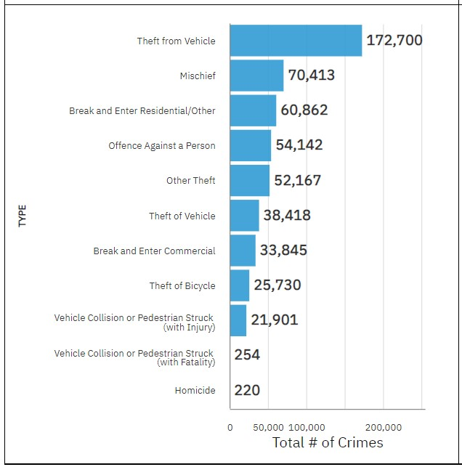
TYPES OF CRIME:
Notes:
The figure shows how the types of crime is classified in Vancouver. Starting off from bottom with homicide the trends increase and it ends with highest crime of theft from vehicle.

Slide 5
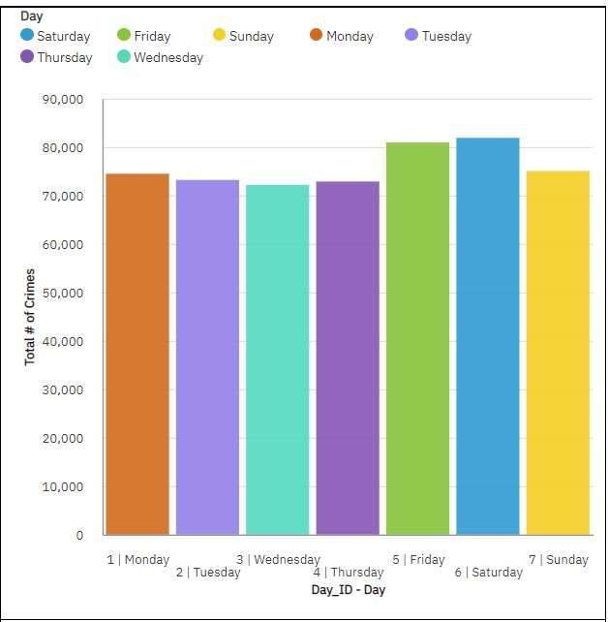
DISTRIBUTION OF CRIMES PER DAY
Increased crime on Fridays and Saturdays compared to other days.
Notes:
As we can see in the bar graph the highest crimes are happening on Fridays and Saturdays and it might be because more and more people are going out on weekends to enjoy and have party.

Slide 6
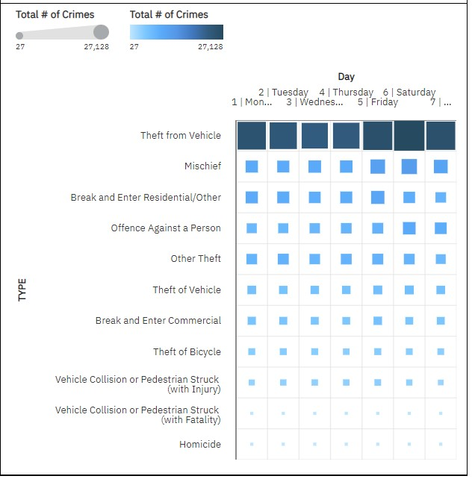
CRIME PER DAY OF THE WEEK
Theft from vehicle is common.
Notes:
Here is the heatmap which shows the bifurcation of crimes along with the days in a week we can see that theft from a vehicle followed by mischief is the most common type of crime on the other hand homicide and vehicle collision are contributing to the least crimes occurring in Vancouver while when observed for the days Fridays and Saturdays have the highest crime when compared to other days in a week.

Slide 7
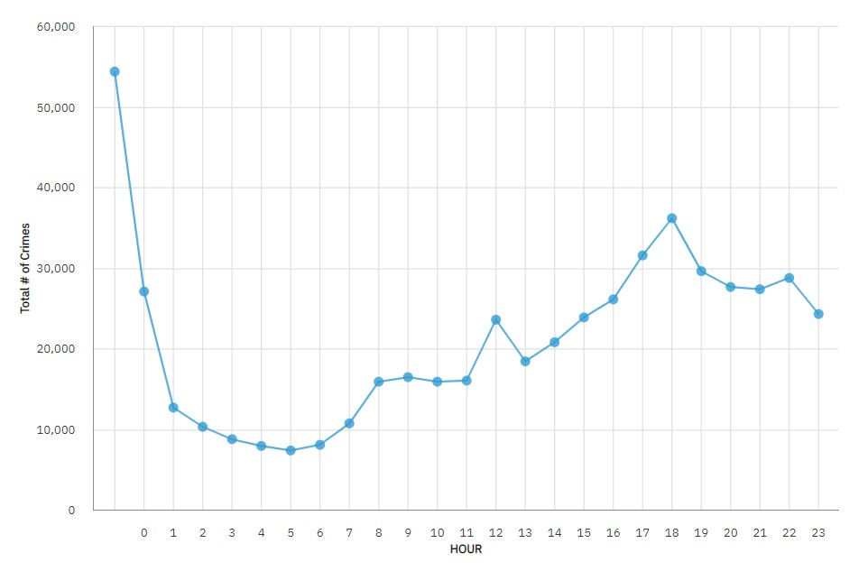
DISTRIBUTION OF CRIMES PER HOUR
Notes:
In this line chart, we can observe that most of the crimes are happening during the time between 0000 to 0100 and the reason behind this might be because most of the people are sleeping on weekdays and going to parties and clubbing during weekends while its least between 0400 to 0600 as most of the people wake up and have jobs in the morning.

Slide 8
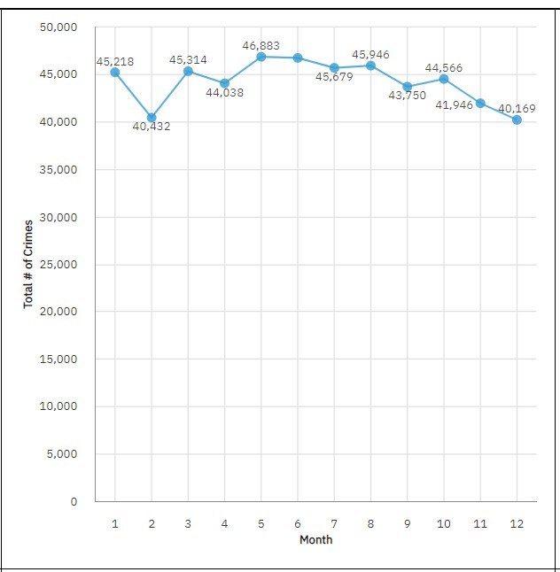
DISTRIBUTION OF CRIME BY MONTH
Notes:
It shows that The highest crime rate happen in the month of May with the number of 46,883 crimes.
The number of crimes per month decreased to around 40,169 in the month of December.
X = Month ID
Y = total # of Crimes

Slide 9
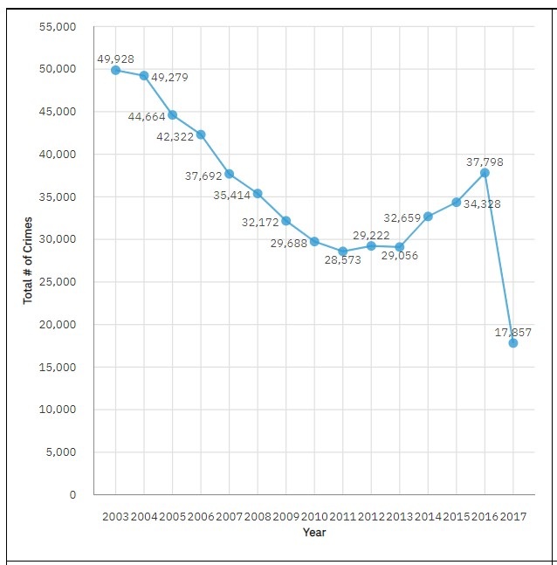
DISTRIBUTION OF CRIMES BY YEAR
Notes:
The year 2003 had the highest crime and gradually it decreased from 2005 to 2009 around 2010 to 2013 it was stable and it gradually increased from 2014 to 2016 and there was a decrease in the year 2017.

Slide 10
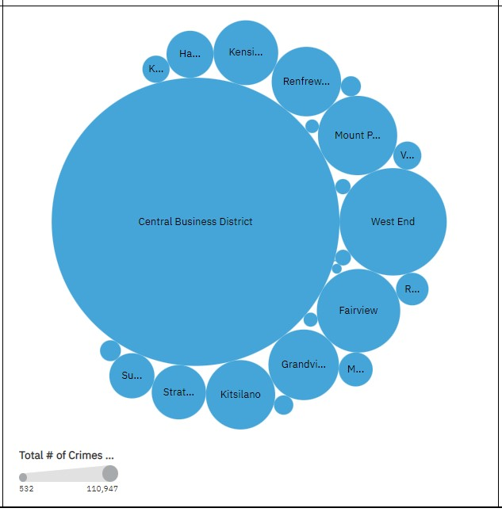
DISTRIBUTION OF CRIMES BY NEIGHBOURHOOD
Notes:
The first dangerous area where most of the crime happen is the central Business District followed by West End neighborhood.
Bubbles: Neighborhood
Size : total # of Crimes

Slide 11
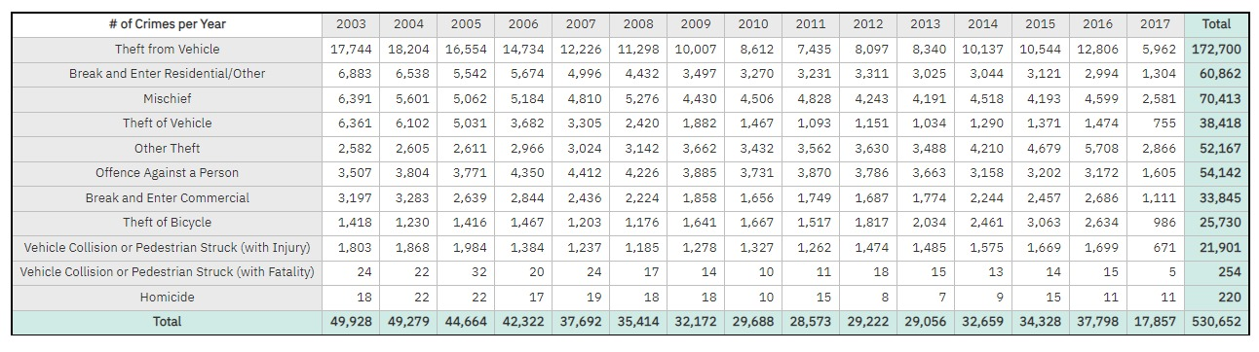
TOTAL NUMBER OF CRIMES:
Notes:
this matrix automatically summarizes data by row and columns. The Total number of crimes happened in Vancouver from 2003-2017 is 530,652. Theft from Vehicle contributed the major number of crimes followed by mischief. The least type of crime that happen in Vancouver over the years is homicide.
Rows : Type of crimes
Columns : Year

Slide 12
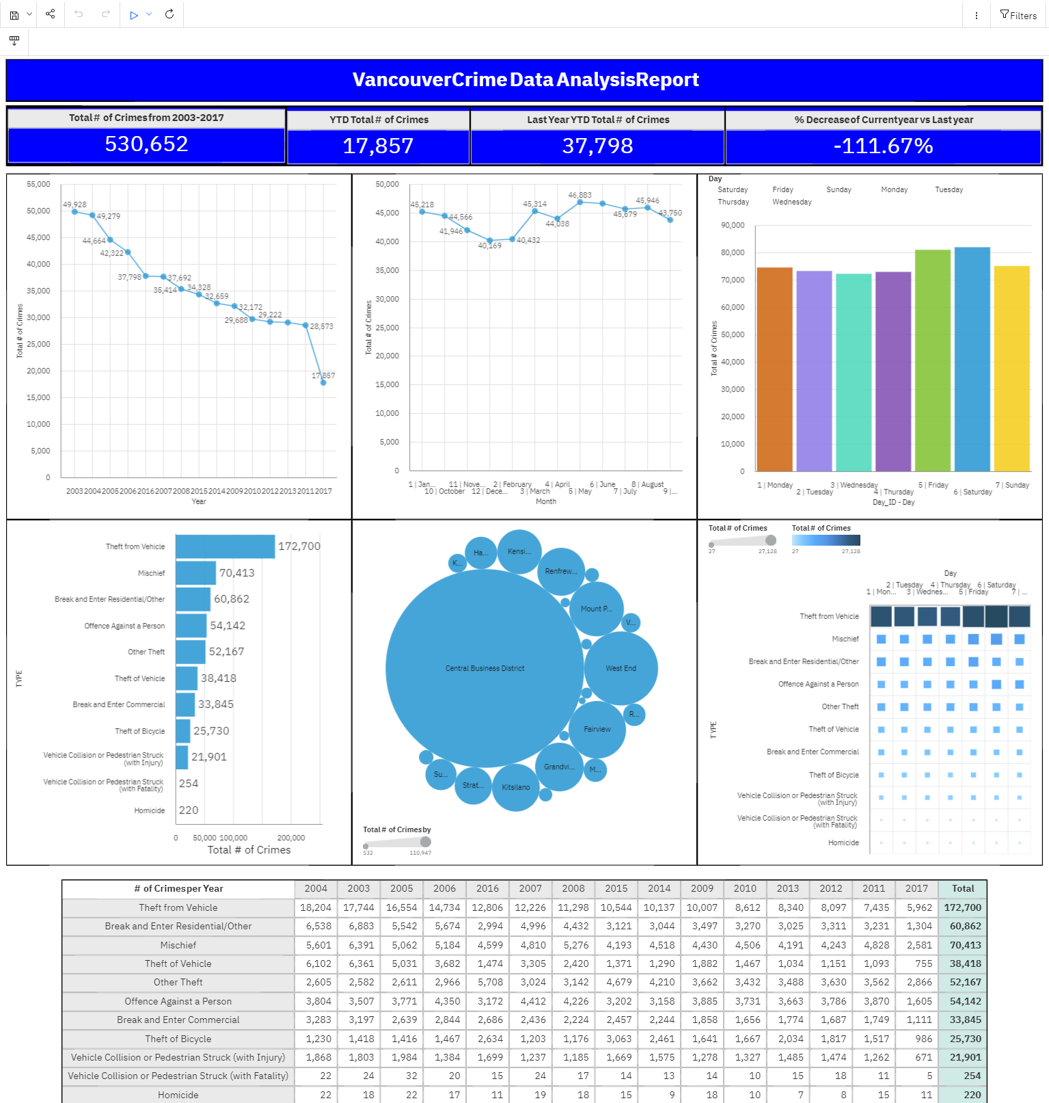
Notes:
The dashboard is a summation of all the graphs
KPIs
Total number of crimes from 2003-2017 is 530,652
2017 YTD total number of crimes is 17,857
2016 YTD total number of crimes is 37,798
The decrease percentage of 2017 vs 2016 is -111.67%.

Slide 13
RECOMMENDATIONS:
Close the windows and lock your doors. (Car)
Park in well-lighted areas.
Even for shorter period lock all doors.
Use alarm systems if financially able.
Use “motion detector” lighting around all sides of your home.
Be an active member of a neighborhood watch program
Increase number of patrols in higher crime rate areas.
Consider having a dog in your family, as dogs have been shown to deter crime
Notes:
Close the windows and always lock the doors of your car.
Park in well-lighted areas and don’t park near shrubs or fences that could provide concealment for criminals.
Close and lock all doors of the house even when leaving for a short period of time.
Use alarm systems if financially able. Simple window alarms can be purchased at most home improvement stores for less than $20.
Use “motion detector” lighting around all sides of your home to dissuade criminals from sneaking in.
Implement and be an active member of a neighborhood watch program.
Increased number of patrols in higher crime rate areas.
Consider having a dog in your family, as dogs have been shown to deter crime
Link: https://www.scarsdale.com/532/Crime-Prevention-Recommendations

Slide 14
CONCLUSION:
Approach for the analysis:
Explore the data
Draw out distinct questions
New insights into crime trends will assist police departments and law enforcement agencies with:
Tracking activities
Predicting the likelihood of incidents
Effectively deploying resources
Optimizing the decision-making process
Notes:
The approach for this analysis was to explore the data and then draw out the distinct questions that come to at the first glance of the data.
The results provide the new insights into crime trends and will assist both police departments and law enforcement agencies.
These provide insights that will enable them to track activities, predict the likelihood of incidents, effectively deploy resources, and optimize the decision-making process.

Slide 15
THANK YOU!

